Slide 1




INDUSTRY 4.0 CELL
INSTITUTE OF AUTOMATION AND COMPUTER SCIENCE

Slide 2




Team Name: Project name
Team members
Brno, 2023
Brno, 2022

Slide 3


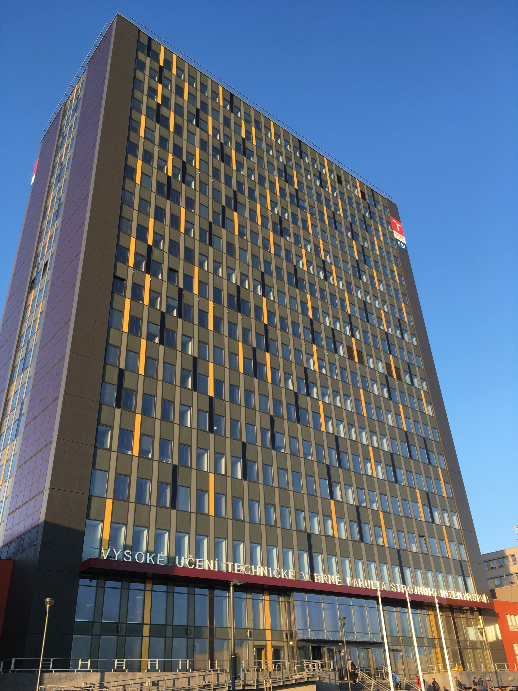
Content
1.
Definition of the Problem, Related Work, etc.
2.
Development Tools, Methods, etc.
3.
Design and Implementation of a Functional Solution
4.
Experiments and Results
4.1
Verification and Validation of Simulation Models
4.1
Real – World Test (optional)
4.1
Advantages / Disadvantages
5.
Conclusion and Future Work
5.1
Video
© TeamName
2023 | Page X/Y
Content

Slide 4
Title of Part X

Slide 5
Title of Part X: Supplementary Description
Text …
Text ….
© TeamName
2023 | Page X/Y
Title of Part X

Slide 6
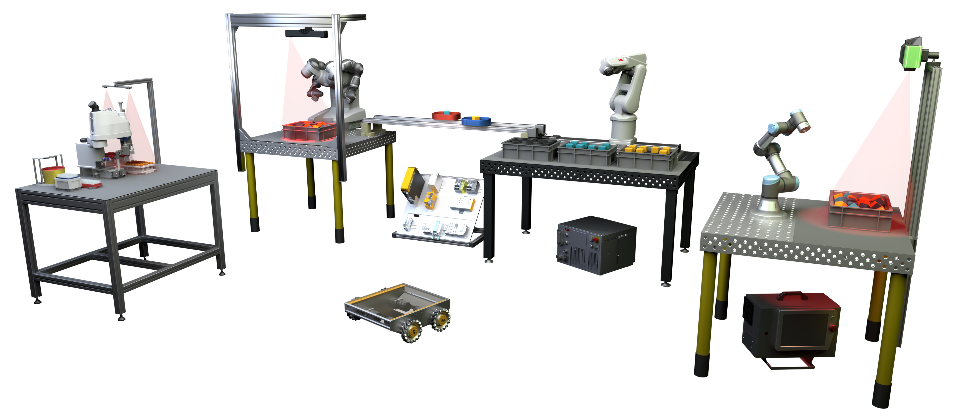
Thank You!

Slide 7
Questions?

Slide 8
INDUSTRY 4.0 CELL
INSTITUTE OF AUTOMATION AND COMPUTER SCIENCE

